Slide 1


Semi-Supervised Semantic Segmentation with Cross Pseudo Supervision
Xiaokang Chen¹, Yuhui Yuan², Gang Zeng¹, Jingdong Wang²
¹Key Laboratory of Machine Perception (MOE), Peking University
²Microsoft Research Asia

Slide 2
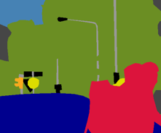
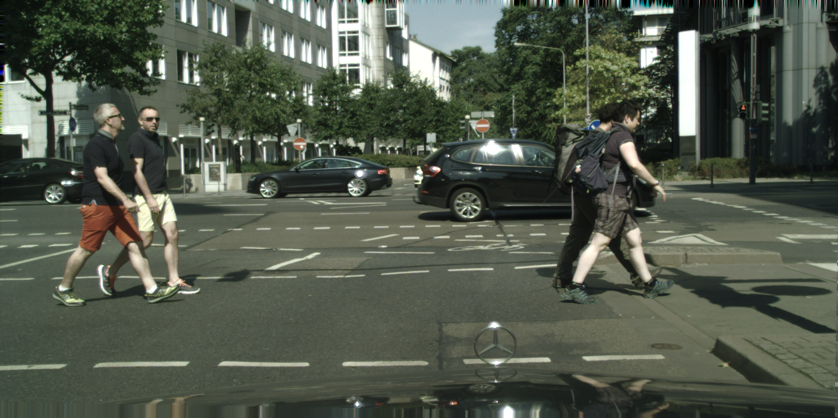
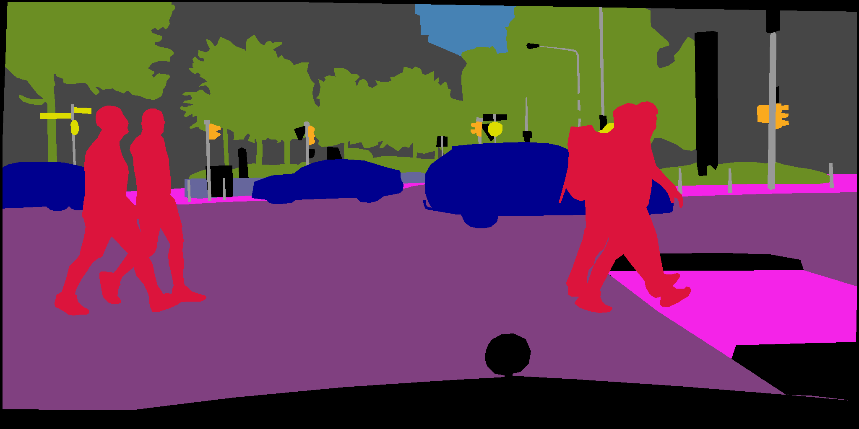
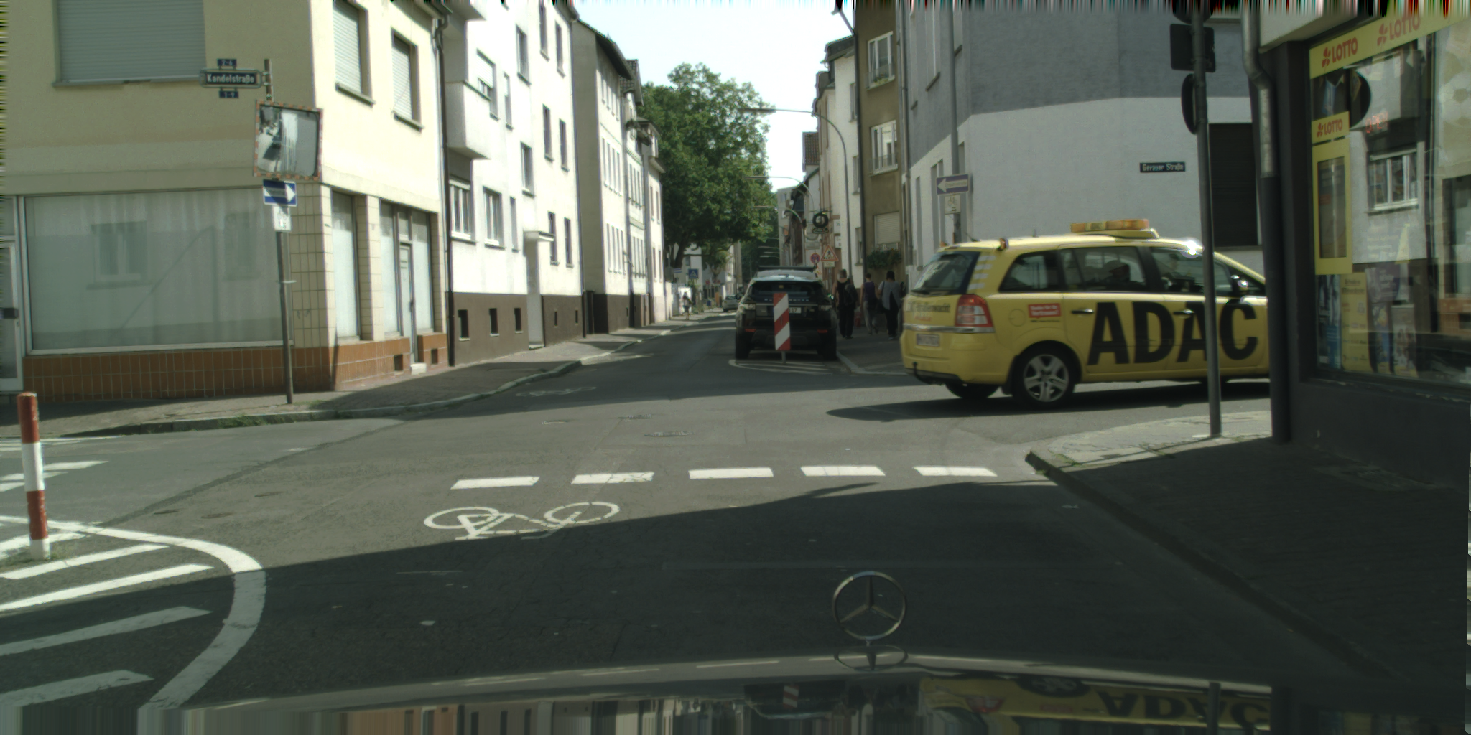
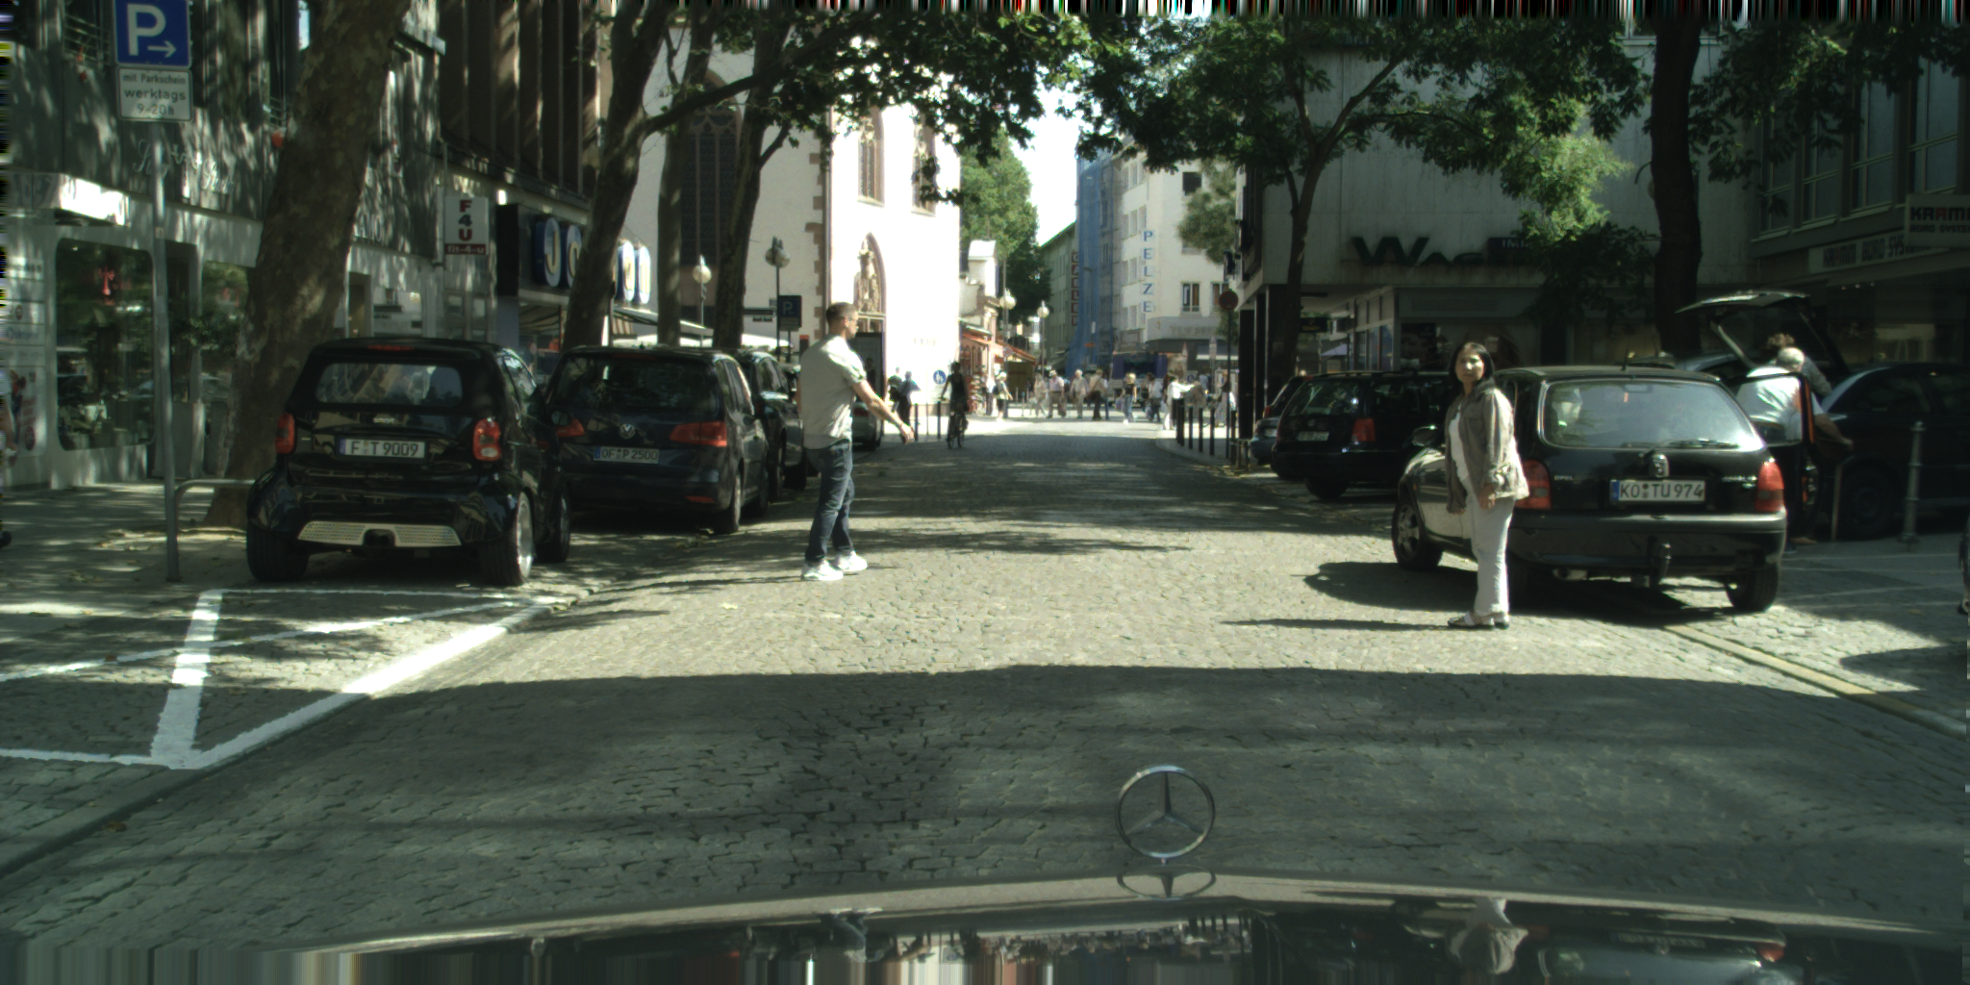
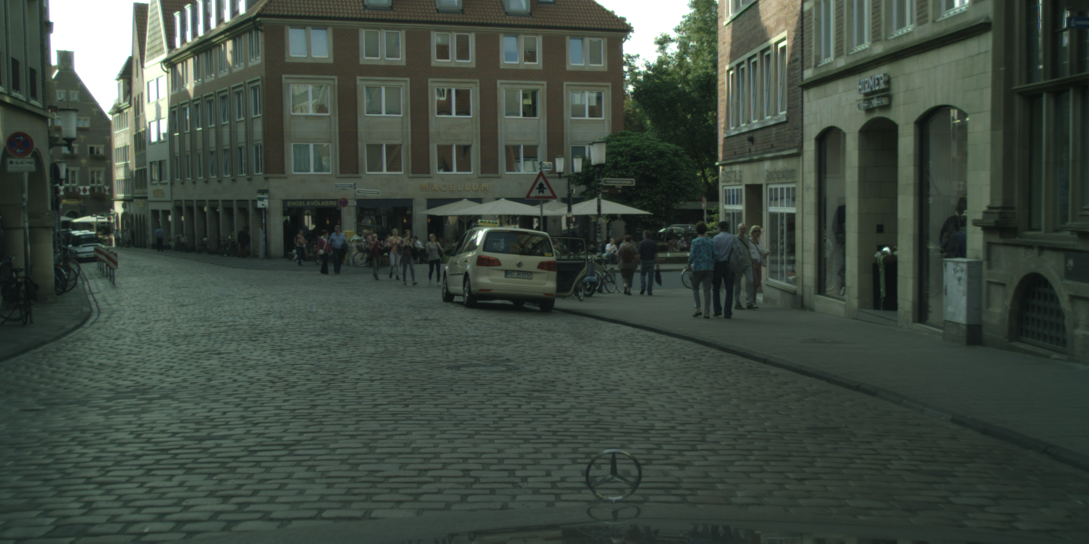
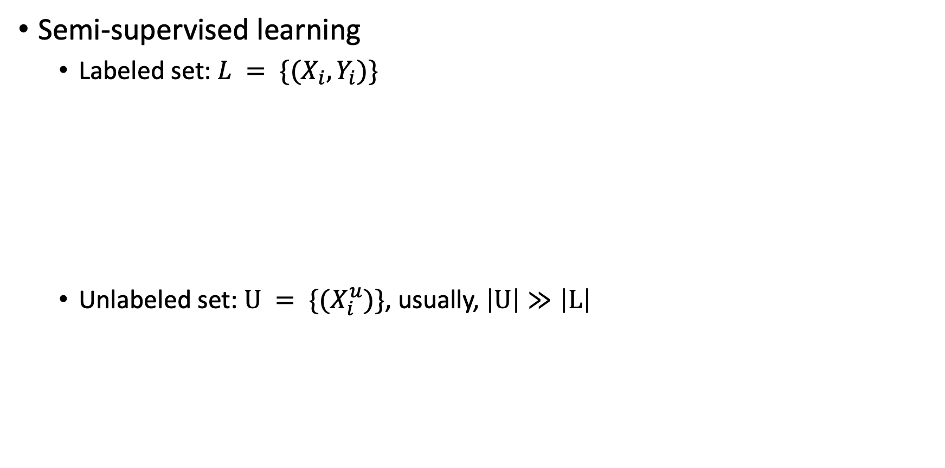
Background
Semi-supervised learning
Labeled set: $L = \{(X_{i}, Y_{i})\}$
Unlabeled set: $U = \{(X_{i}^{u})\}$, usually, $\left|U\right|≫\left|L\right|$
Ground-truth Mask

Slide 3



Background
Two Solutions for Semi-supervised Segmentation
Self training—offline
Consistency learning—online
Labeled set
Neural Network
Labeled set
Unlabeled set
Neural Network
Labeled set
Unlabeled set
Neural Network

Slide 4
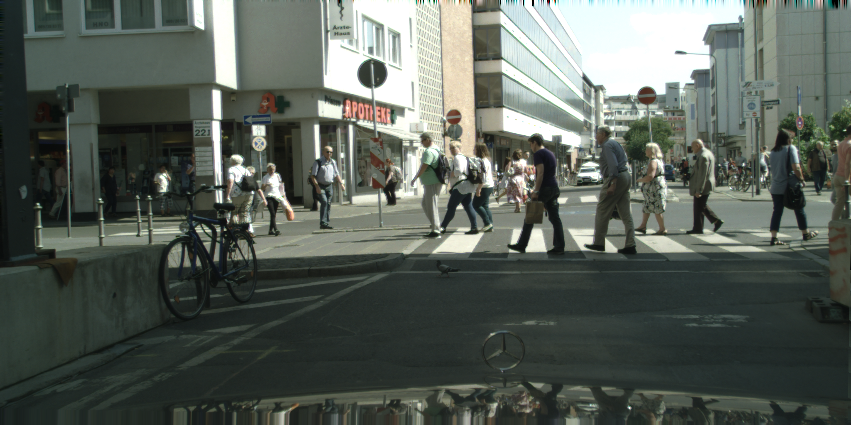
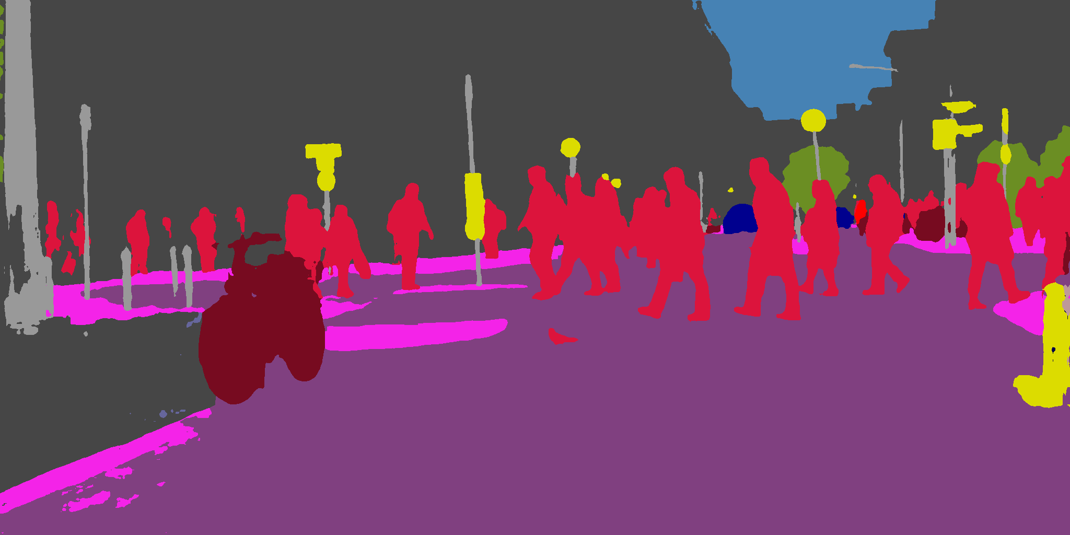
Solution I: Self Training
Forward
Backward
Train a model $f\left(θ, x\right)$ on the labeled set $L = \{(X_{i}, Y_{i})\}$
Neural Network
Generate pseudo labels for the unlabeled set $U = \left\{\left(X_{i}^{u}\right)\right\}$
Neural Network
Re-train a new model on the whole set.

Slide 5



Solution II: Consistency Learning
The key idea is to encourage the network to give consistent predictions for unlabeled inputs that are perturbed in various ways.
Raw
Rotation
Jittering

Slide 6
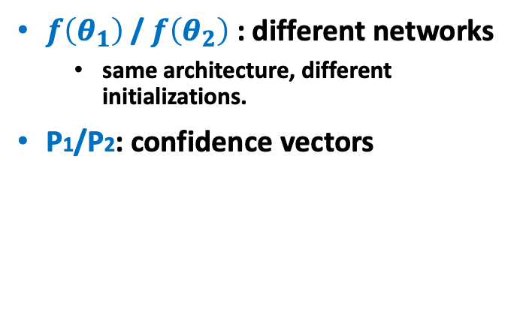
A Typical Example of Consistency Learning
CPC: Cross probability consistency [1] (ECCV 2020)
$f\left(θ_{1}\right)$/ $f\left(θ_{2}\right)$: different networks
same architecture, different initializations.
P1/P2: confidence vectors
[1] Guided Collaborative Training for Pixel-wise Semi-Supervised Learning

Slide 7
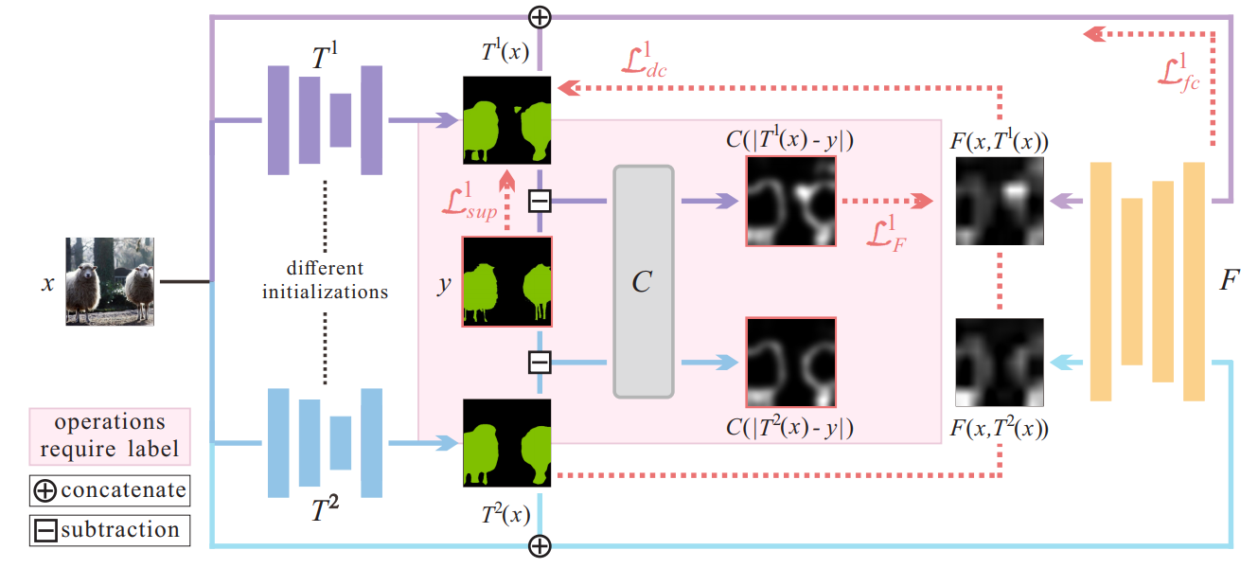
Motivation of Our CPS
How about the combination of self training and CPC?
Self training could expand the labeled set through pseudo labelling.
CPC encourages the network to learn a compact feature embedding through consistency learning.
Neural Network

Slide 8
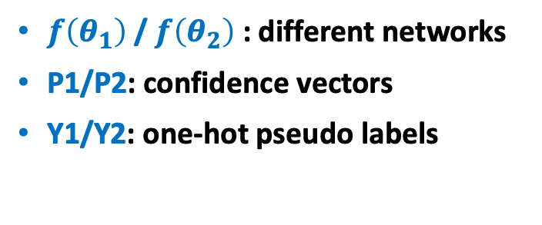
Our Cross Pseudo Supervision (CPS)
$f\left(θ_{1}\right)$/ $f\left(θ_{2}\right)$: different networks
P1/P2: confidence vectors
Y1/Y2: one-hot pseudo labels

Slide 9
Two Roles of CPS
Encouraging high similarity between the predictions of two perturbed networks for the same input image, thus the decision boundary lies in low-density regions.
Expanding training data by using the unlabeled data with pseudo labels. It is better than self training because the consistency learning ensures a more compact feature space.

Slide 10
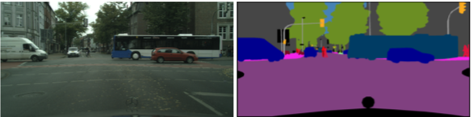
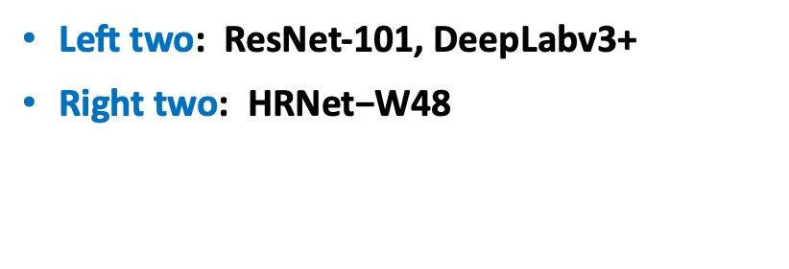
Strong performance of CPS
Cityscapes validation set, single scale testing.
3K labeled data (standard training set)
3K unlabeled data (randomly sample from the coarse-labeled set but no GT masks are used here)
$\text{Left} \text{two}\text{: }$ResNet-101, DeepLabv3+
Right two$\text{: } \text{HRNet}\text{−}\text{W}\text{48}$

Slide 11
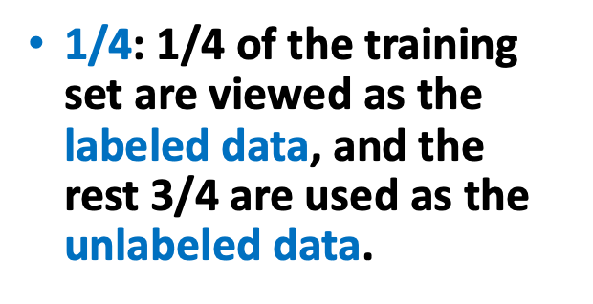
Comparison with Self Training
CPS could be viewed as online version of self training.
$\text{1/4}\text{:} \text{1/4} \text{of} \text{the} \text{training} \text{set} \text{are} \text{viewed} \text{as} \text{the} \text{labeled} \text{data}\text{,} \text{and} \text{the} \text{rest} \text{3/4} \text{are} \text{used} \text{as} \text{the} \text{unlabeled} \text{data}\text{.}$

Slide 12
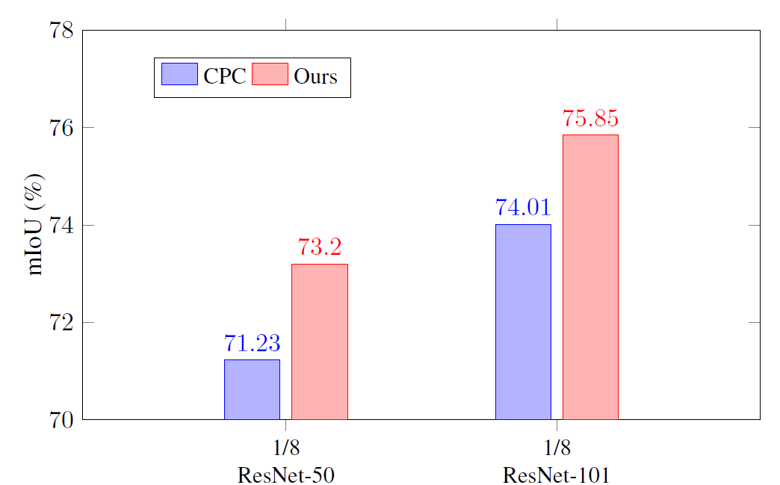
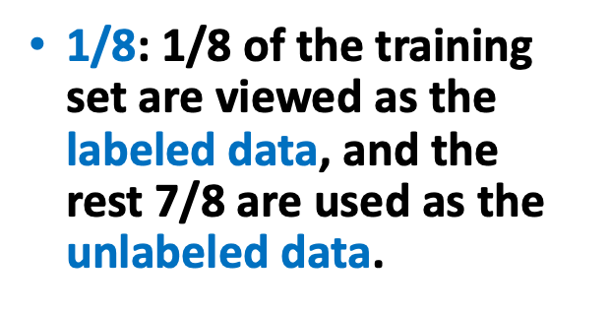
Comparison with CPC
$\text{1/8}\text{:} \text{1/8} \text{of} \text{the} \text{training} \text{set} \text{are} \text{viewed} \text{as} \text{the} \text{labeled} \text{data}\text{,} \text{and} \text{the} \text{rest} \text{7/8} \text{are} \text{used} \text{as} \text{the} \text{unlabeled} \text{data}\text{.}$

Slide 13
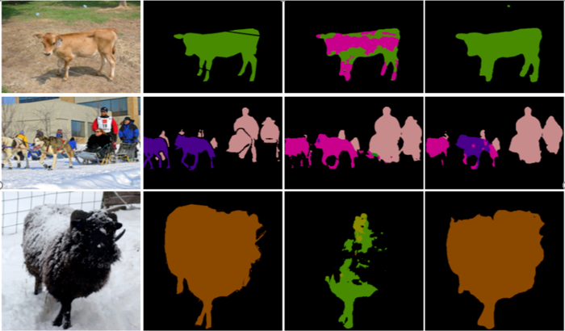
Qualitative Results
PASCAL VOC, labeled ratio = 1/8
input
ground truth
supervised only
ours

Slide 14
Conclusion & Future Work
Conclusion
We propose a simple but effective semi-supervised segmentation framework, which imposes the consistency between two networks with different initializations. Besides, our approach could expand the training data through online pseudo labelling, which is better than self training.
Future Work
Change the initialization manner of two networks, E.g., carefully design a certain distribution.
If the two networks differs more, will the results be better?
Theoretical analysis behind CPS.

Slide 15
Thank you for listening!

